Slide 1
Street Dance
LESSON OBJECTIVES:
Know how to dance safely
Understand why we warm up
Be able to create our own warm up
Develop our own and group choreography
To evaluate and review our progress so far with a a log sheet

Slide 2
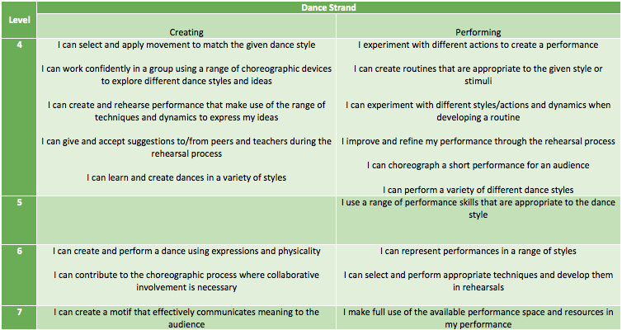
Success Criteria

Slide 3

Why do we warm up?

Slide 4
3 reasons to warm up
Prepares our mind and bodies for dance
To raise the heart getting the blood pumping all round our bodies, carrying oxygen to muscles (aerobic exercise)
To warm our muscles up so we don’t pull or tear them, making them more flexible (stretchy) (anaerobic exercise)

Slide 5
What sort of exercises do we do in a warm up?
What might we do to increase our heart rate?
What might we do to warm our legs up?
What might we do to warm our arms/shoulders up?
What might we do to prepare our minds/focus for dance?

Slide 6
How can we use these exercises to become stronger street dancers?
The more stretches we do, the more flexible we will become and the more moves we can do.
The more we raise our heart rate, the fitter we become, meaning we can perform for longer

Slide 7
Create your own warm up…
In groups of 2 or 3 make up your own warm up
It must be at least 24 counts long
It must get our heart rates going (aerobic)
It must stretch and warm up our muscles

Slide 8
Lets Dance!
Warm up
Small group
choreography
Cool down

Slide 9
SMALL GROUP CHOREOGRAPHY
Get into groups of no more than 4.
Using the given piece of music, create the following:
An opening position- using different levels
Create the first 2 counts of 8 concentrating on:
Formations
Canon
Unison
Musicality
Once you have created the movement you need to REHEARSE

Slide 10
FORMATIONS
CIRCULAR
TRIANGULAR
DIAGONAL
V SHAPE
HORSESHOE
HORIZONTAL AND VERTICAL LINE
ZIG ZAG

Slide 11
KEY DANCE TERMINOLOGY
CANON
UNISON
PERFORMING THE SAME MOVEMENT BUT ONE AFTER THE OTHER. LIKE A DOMINO EFFECT.
PERFORMING THE SAME MOVEMENT AT EXACTLY THE SAME TIME AS OTHER PERFORMERS

Slide 12
Plenary
What have you enjoyed?
What have you found challenging?
What have you learnt?
How have you progressed?
What can you improve on next time?
Well done!

